Slide 1
The Hubble Space Telescope (HST) Advanced Camera for Surveys (ACS) Quicklook Application
Matthew Bourque
October 19, 2017

Slide 2
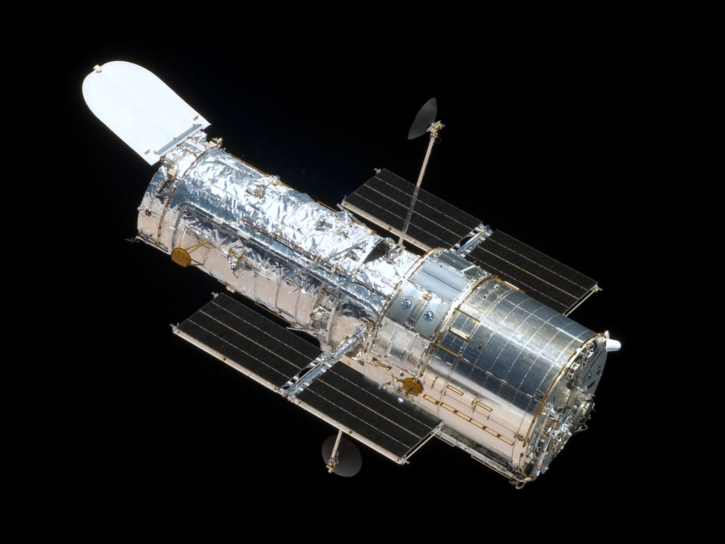
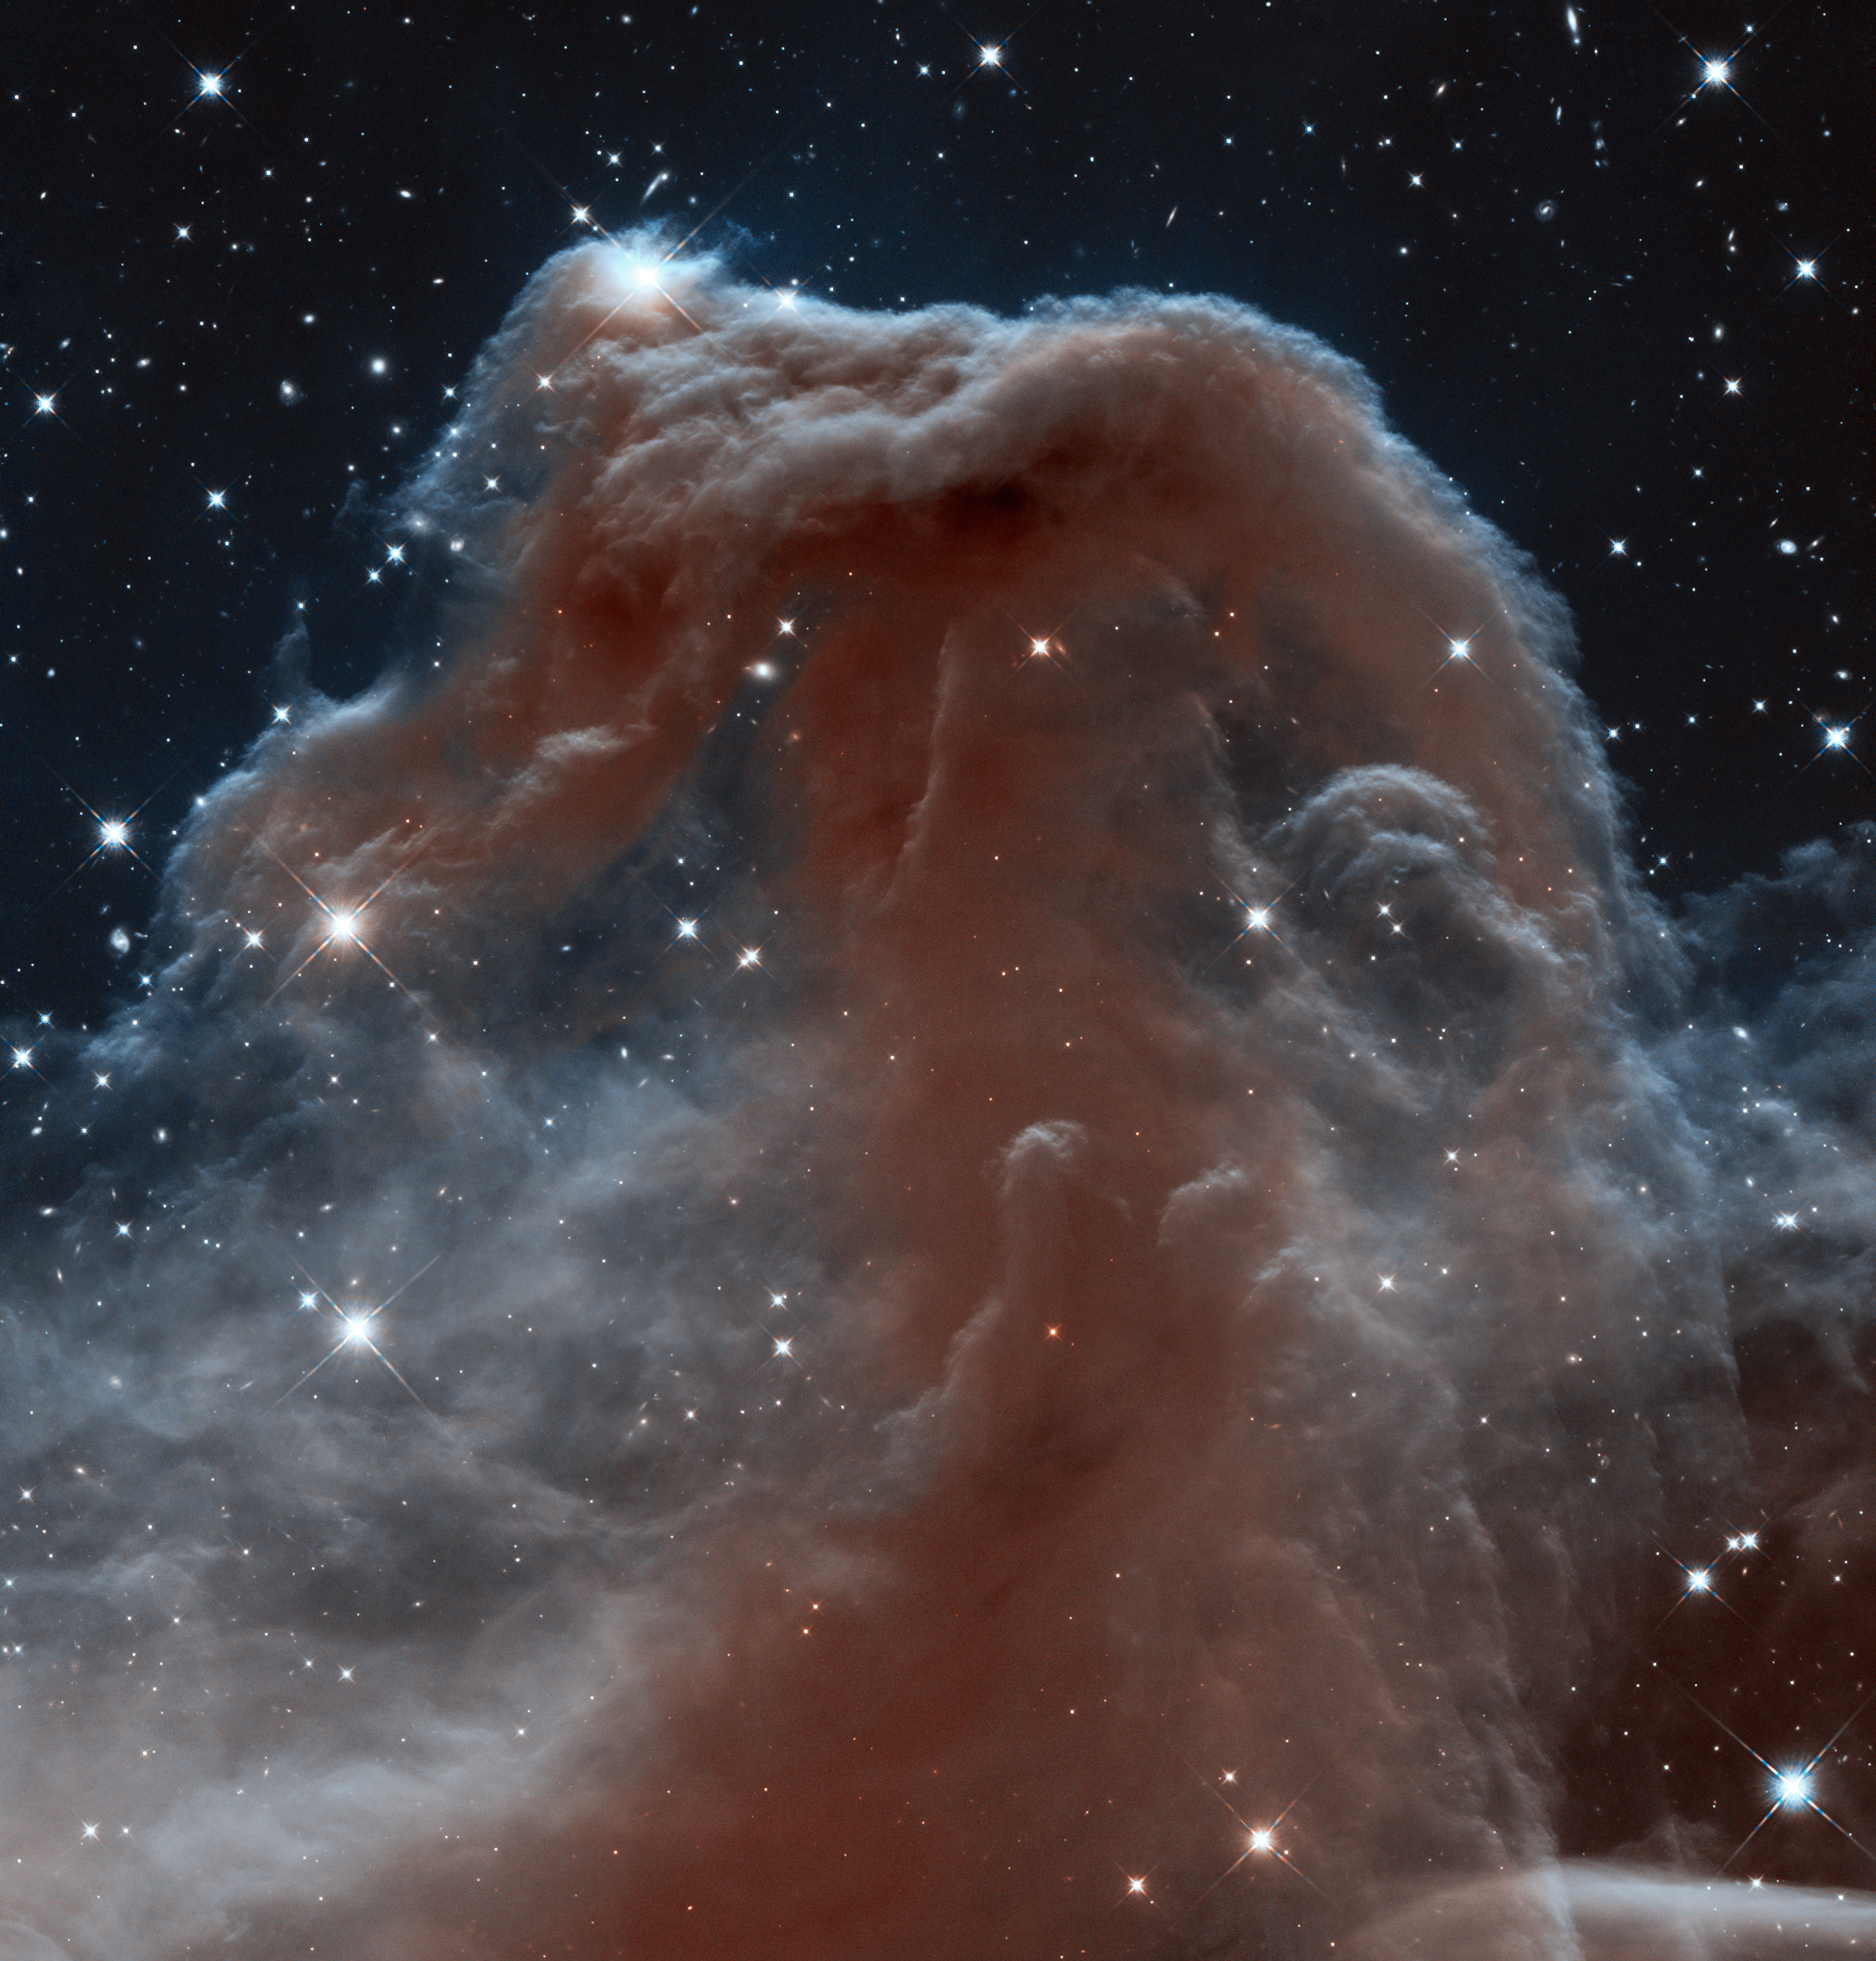
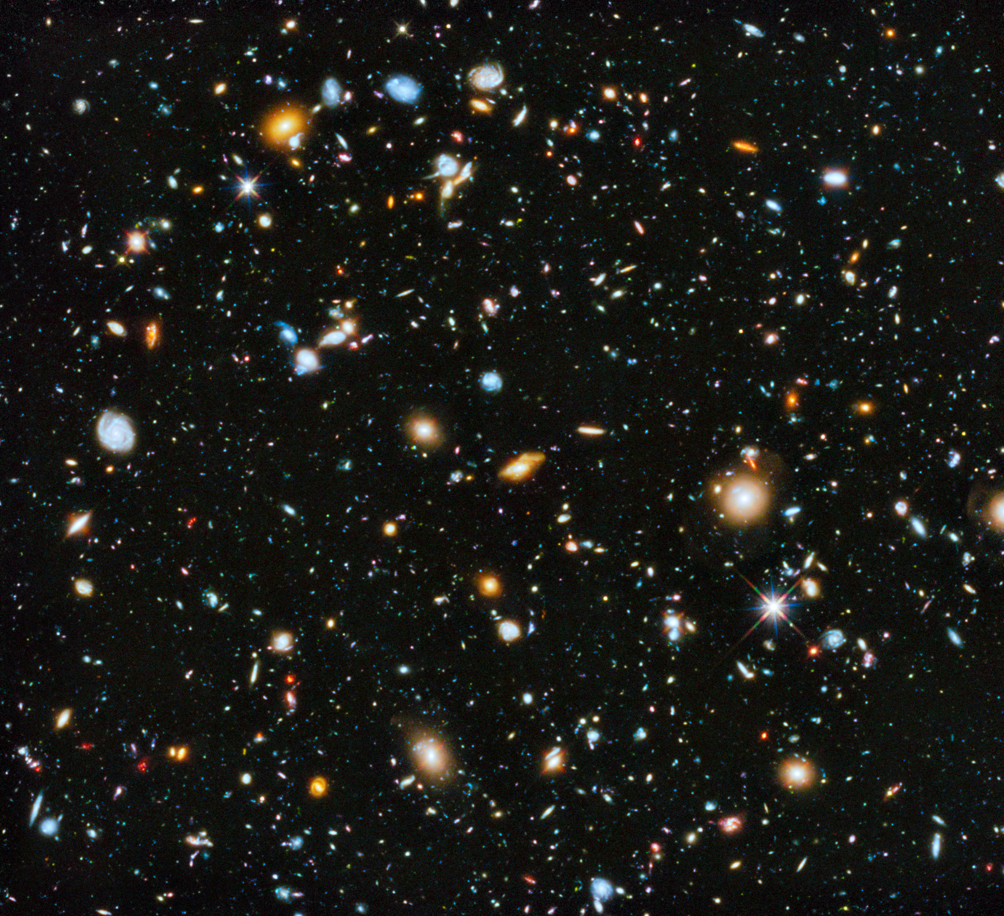
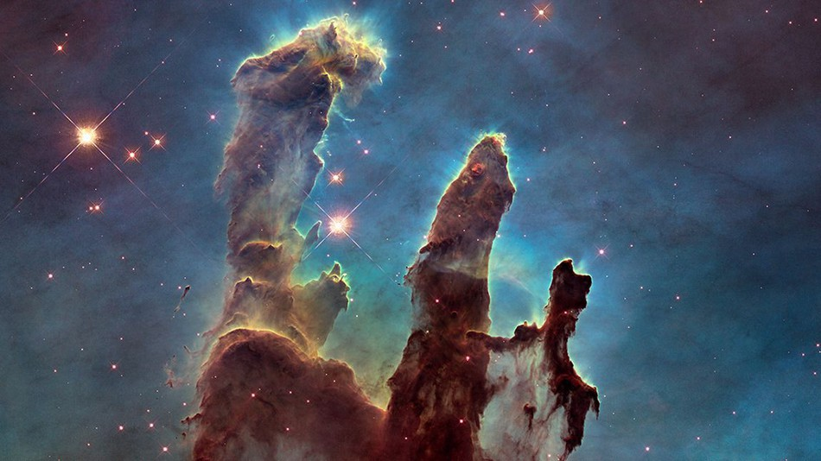
The Hubble Space Telescope (HST)
HST was launched in 1990
Over the years it has housed 12 instruments
5 Servicing Missions
Currently there are 4 instruments on board:
Cosmic Origins Spectrograph (COS) (2009)
Space Telescope Imaging Spectrograph (STIS) (1990)
Wide Field Camera 3 (WFC3) (2009)
Advanced Camera for Surveys (ACS) (2002)

Slide 3
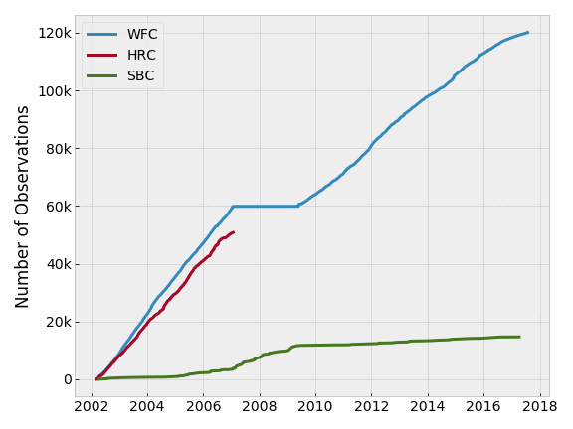
The Advanced Camera for Surveys (ACS)
Comprised of three imaging detectors:
Wide Field Channel (WFC)
High Resolution Channel (HRC)
Solar Blind Channel (SBC)
ACS experienced an electronics failure in 2006, temporarily disabling the WFC detector and permanently disabling the HRC detector.

Slide 4
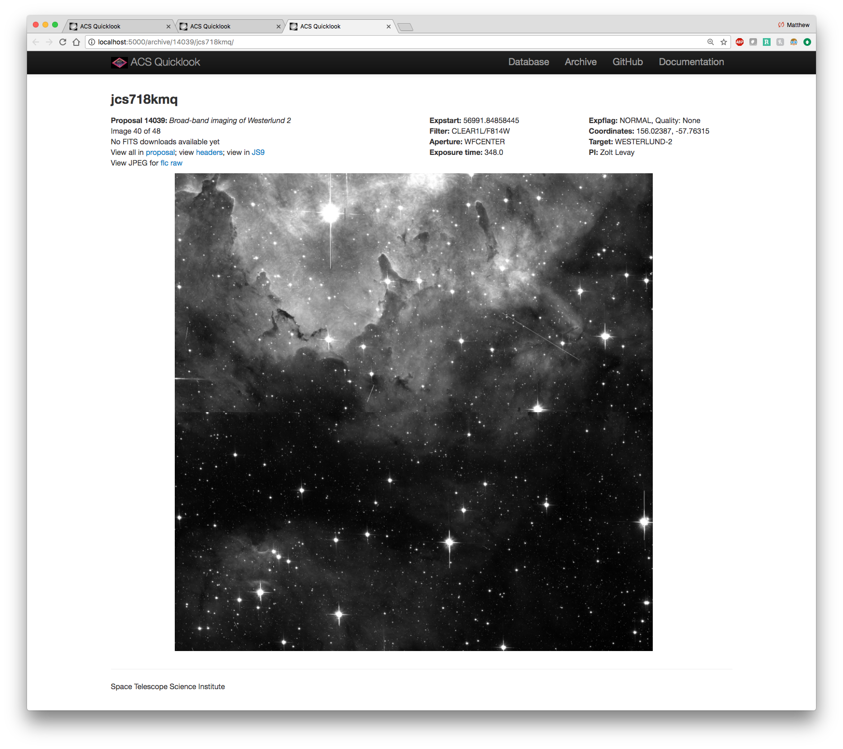
The HST/ACS Quicklook Application (acsql)
Database-driven web application for discovering and viewing HST/ACS images and corresponding metadata
All publicly-available on-orbit data
Comprised of four major components:
Network Filesystem
MySQL Database
Python/Flask-based Web Application
Software Package
Inspired by a similar application for the HST/WFC3 instrument (“WFC3 Quicklook”)

Slide 5
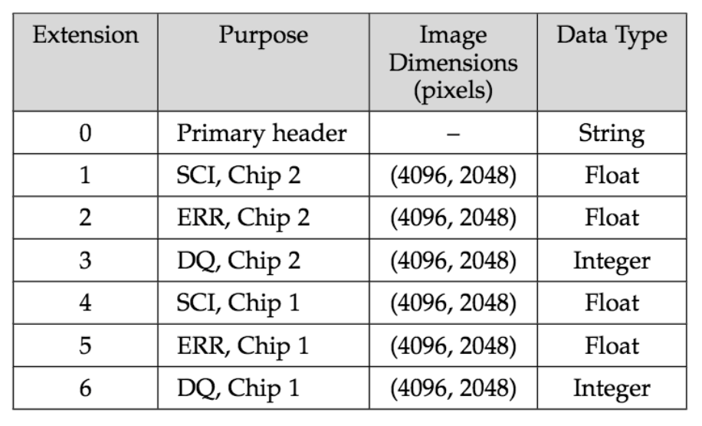
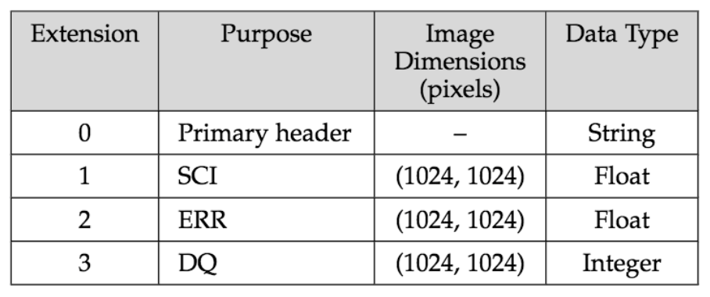
Data Structure: FITS Files
FITS = Flexible Image Transport System
ACS/WFC FITS file structure
ACS/WFC and ACS/SBC FITS file structure

Slide 6
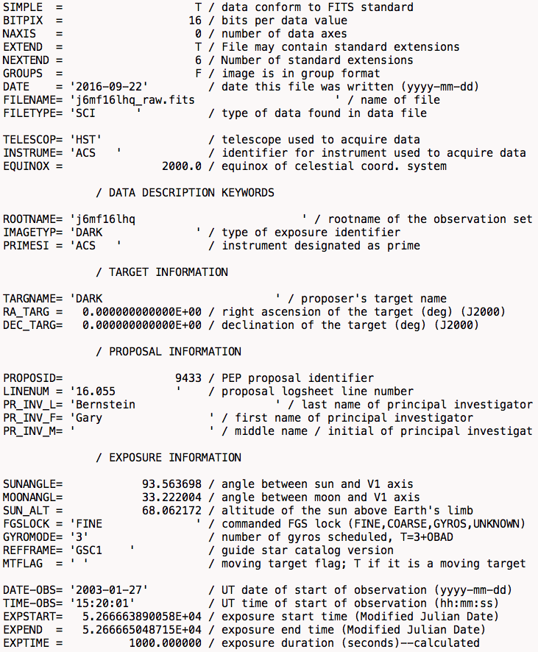
Data Structure: FITS file headers and key metadata
APERTURE – Portion of detector used during observation
DATE-OBS – The date of the start of the observation
DEC_TARG – The declination of target in the night sky
DETECTOR – The detector used (WFC, HRC, or SBC)
EXPSTART – The exposure start time
EXPFLAG – The quality of the exposure
EXPTIME – The duration of the exposure
FILTER – The wavelength filter used during observation
IMAGTYP – The type of image (e.g. “EXTERNAL”)
OBSTYPE – The type of observation (e.g. “IMAGING”)
proposal_type – The type of proposal (e.g. “CAL”)
PROPID – The 5-digit proposal ID
RA_TARG – The right-ascension of the target in the night sky
rootname – The 9-character unique identifier for the observation
SUBARRAY – Boolean value for if an image was a full-frame or not
TARGNAME – The name of the observation target (e.g. “Saturn”)
TIMEOBS – The time of the start of the observation

Slide 7
Data Structure: ACS FITS Filetypes and Rootnames
Rootnames consist of a 9-character identifier corresponding to a unique observation
Available filetypes:
raw - the raw, uncalibrated data that comes directly from HST
flt - nominally calibrated data
flc - nominally calibrated data corrected for Charge Transfer Efficiency (CTE) deficits.
drz - geometric distortion-corrected data
drc - geometric distortion-corrected and CTE corrected data
spt - telescope telemetry data
jit - telescope pointing data
jif - telescope drifting data
crj - cosmic ray rejected data
crc - cosmic ray rejected plus CTE corrected data
asn - observation association table.

Slide 8
Intended Users and Use Cases
The primary user of the acsql application are ACS Instrument Analysts at STScI
They use ACS data to perform instrument calibration and monitoring
External users to STScI are possible since acsql is non-proprietary
Use case 1: Visually inspect an image from the ACS archive
Use case 2: Determine which datasets exist in the ACS archive for a given set of observational parameters
Use case 3: Determine the observational parameters for a given dataset
Use case 4: Programmatically analyze images across custom datasets

Slide 9
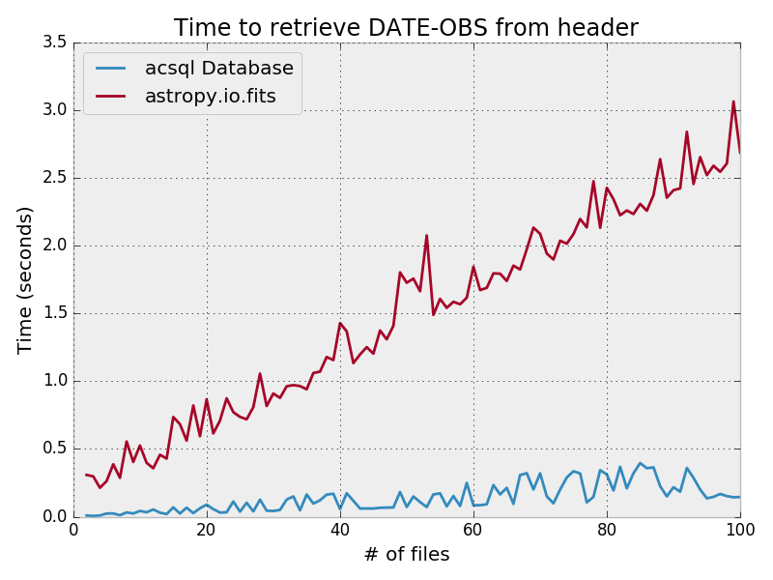
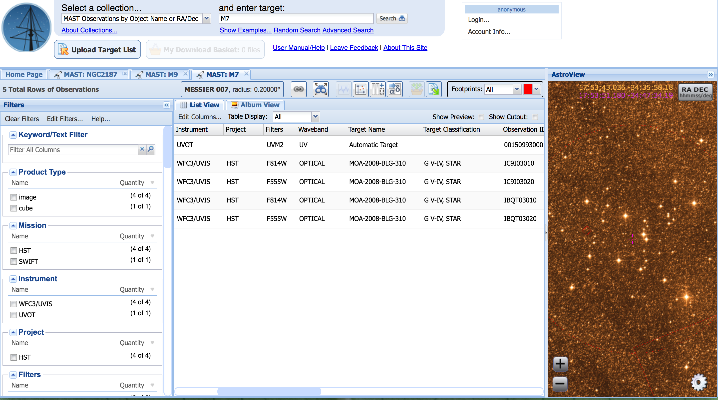
Motivation
Limitations in the FITS file structure (namely File I/O)
Limitations in the current STScI data archive
Data retrieval latency
Data discovery
Data redundancy
acsql is a centrally-located instantly-accessible data archive with one-to-one correspondence with the ACS FITS file headers
No complicated data retrieval process
No need for file I/O
Intuitive database queries

Slide 10
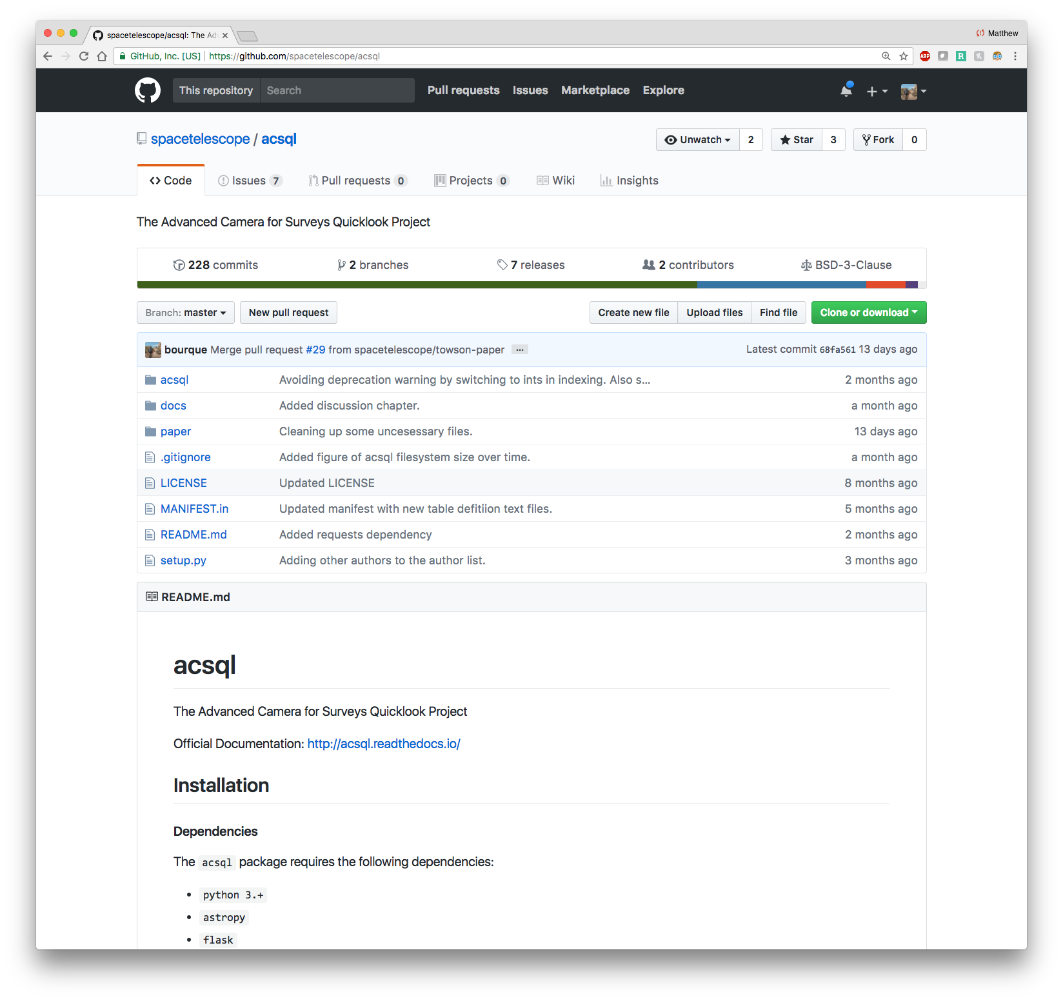
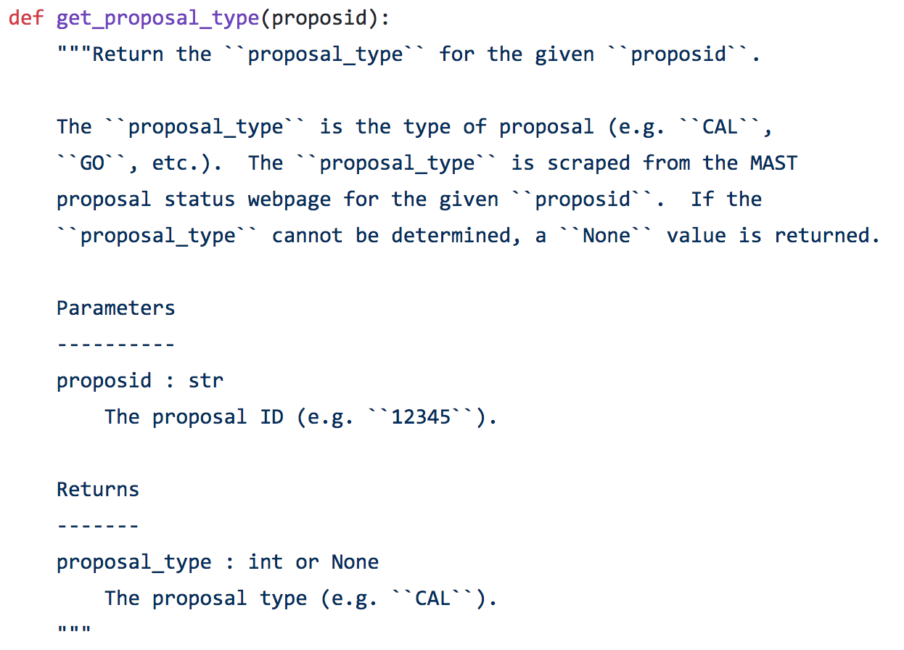
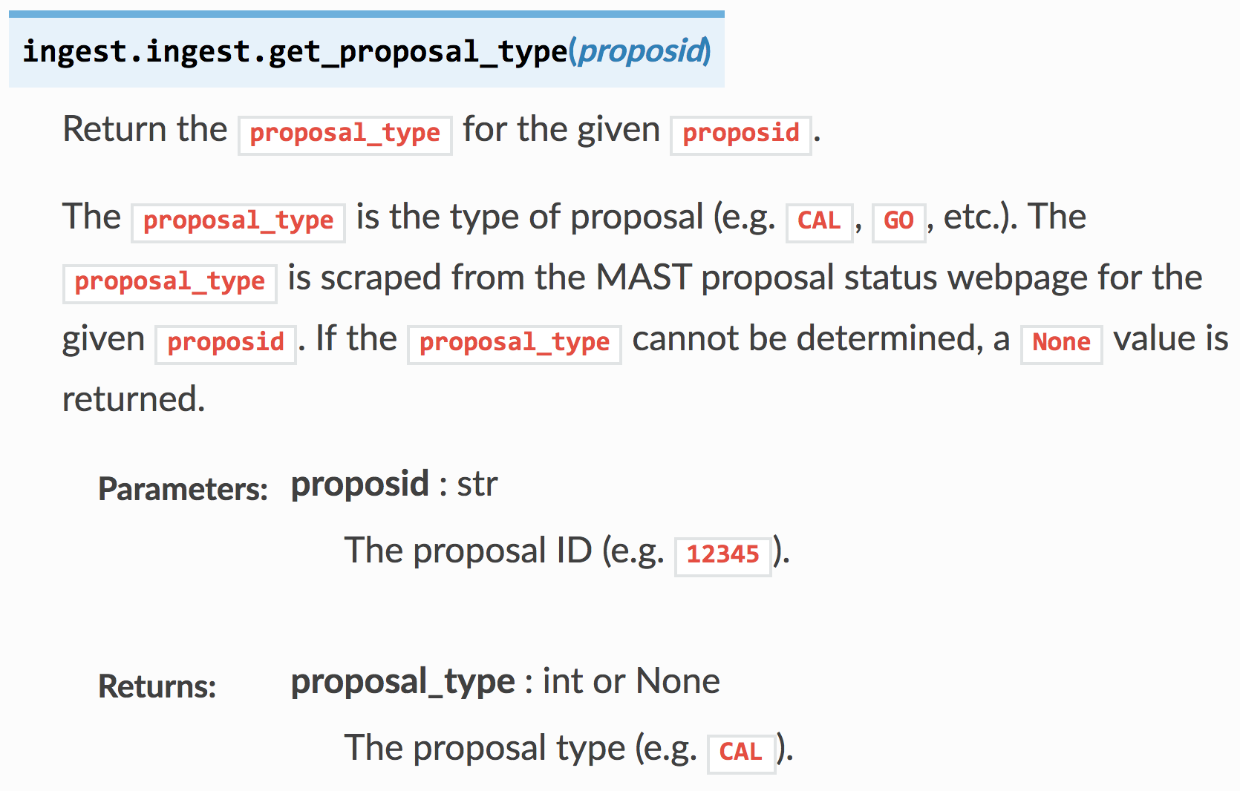
Implementation: Version Control, Programming Standards, and API Documentation
Style Guide for Python (PEP8)
Style Guide for Python Docstrings (PEP257)
numpydoc Documentation Convention
git + GitHub
readthedocs

Slide 11
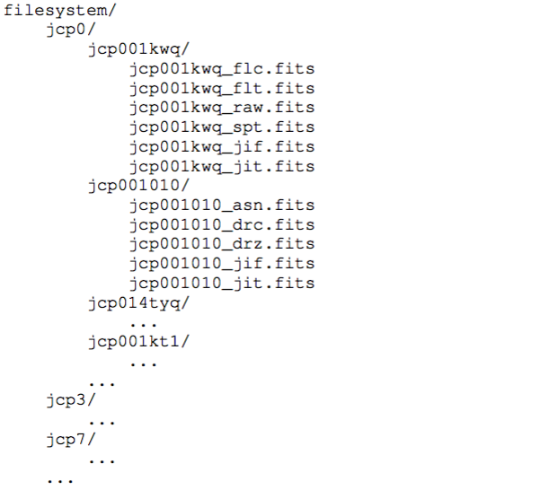
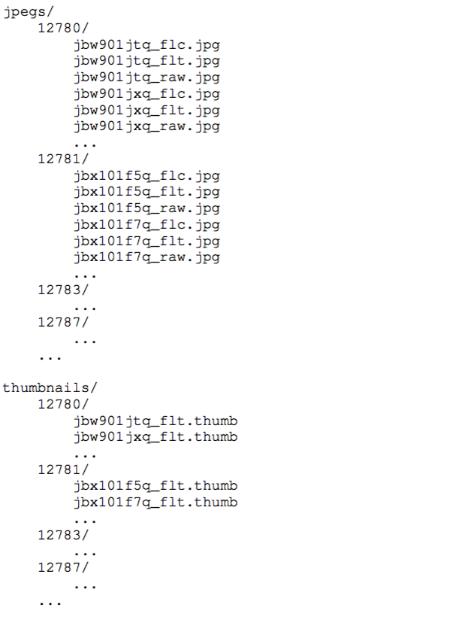
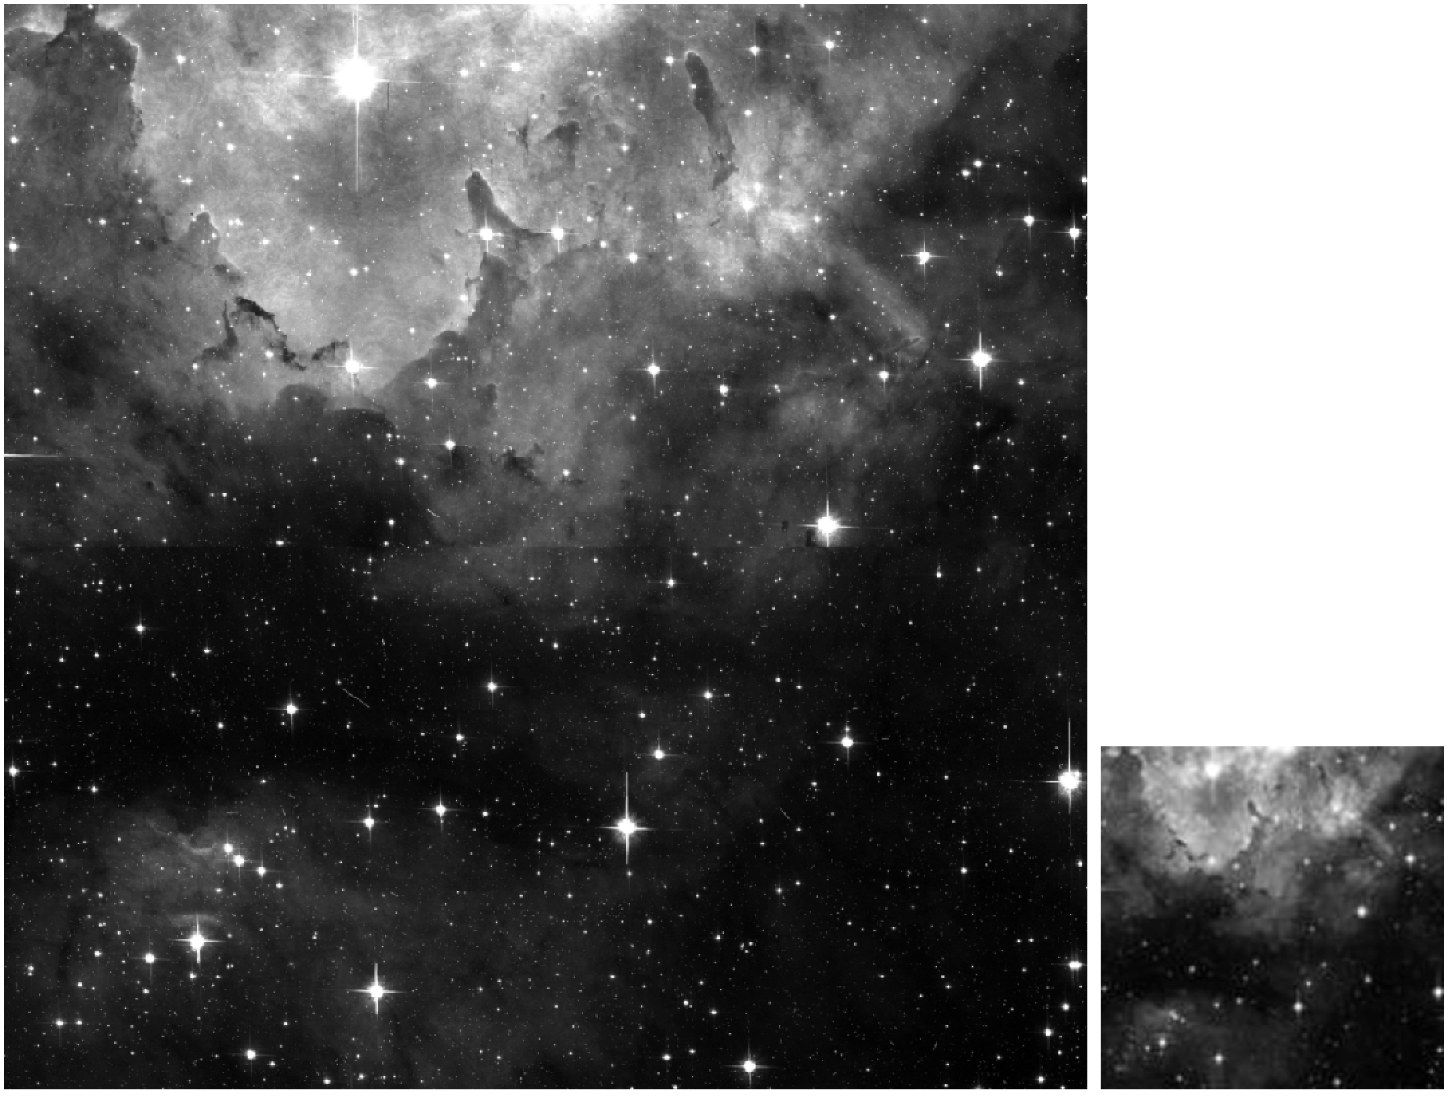
Implementation: Filesystem

Slide 12
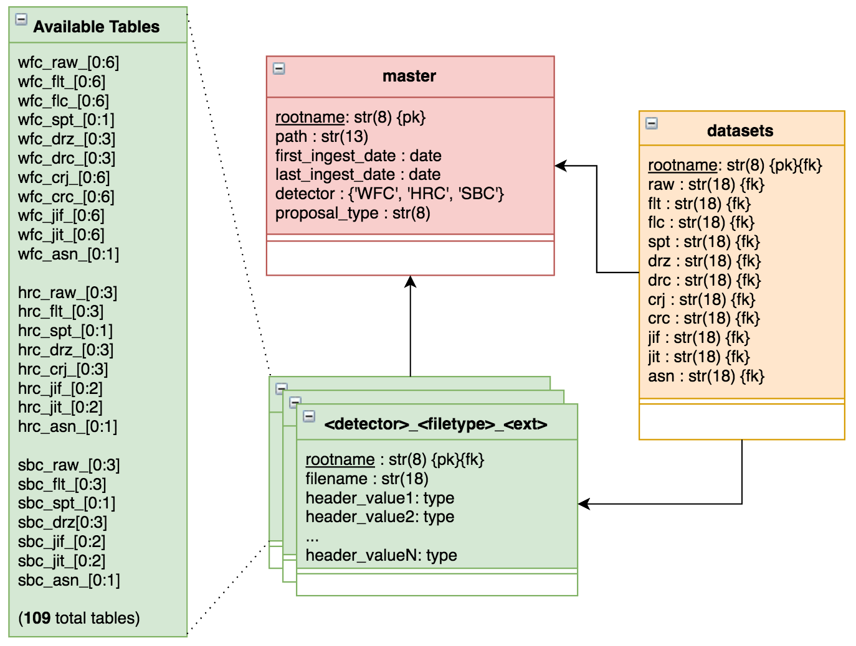
Implementation: Database Schema

Slide 13
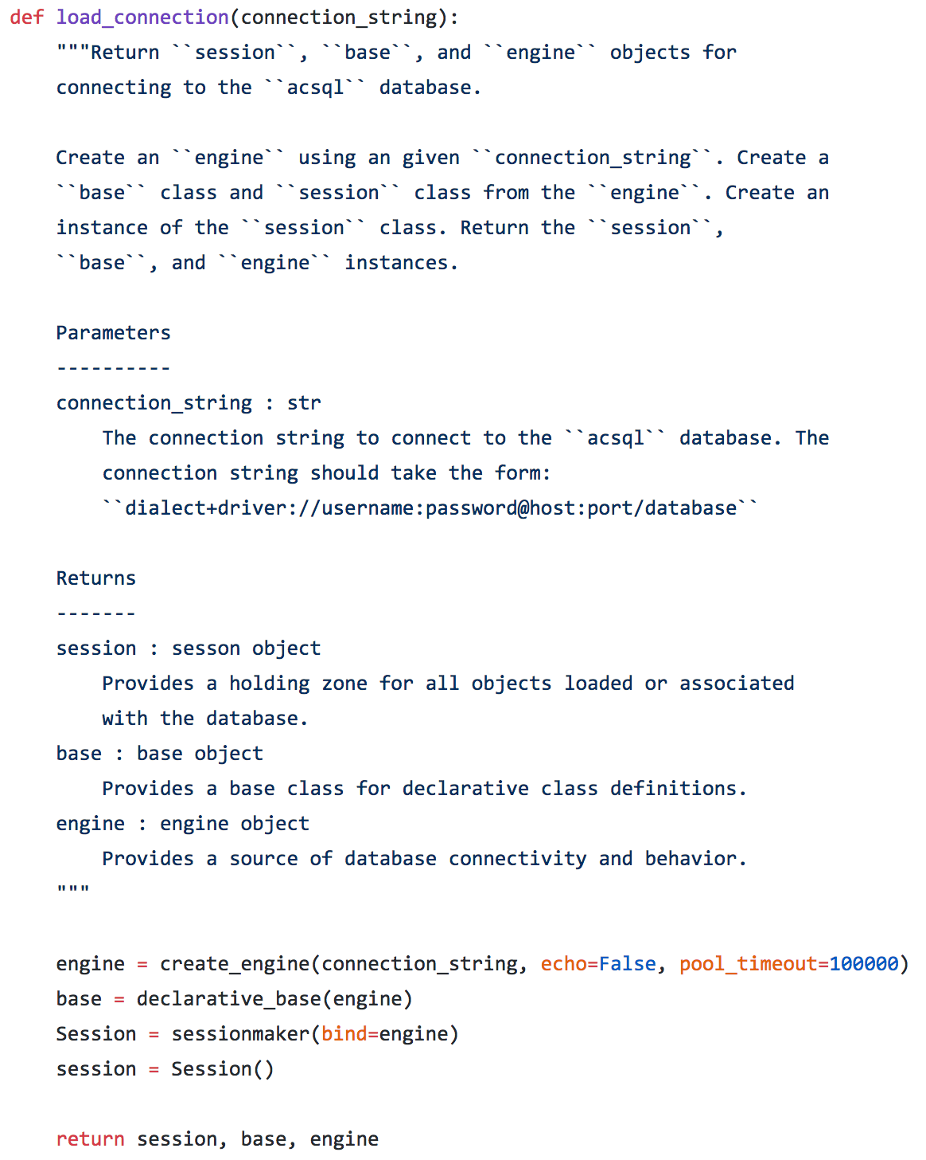
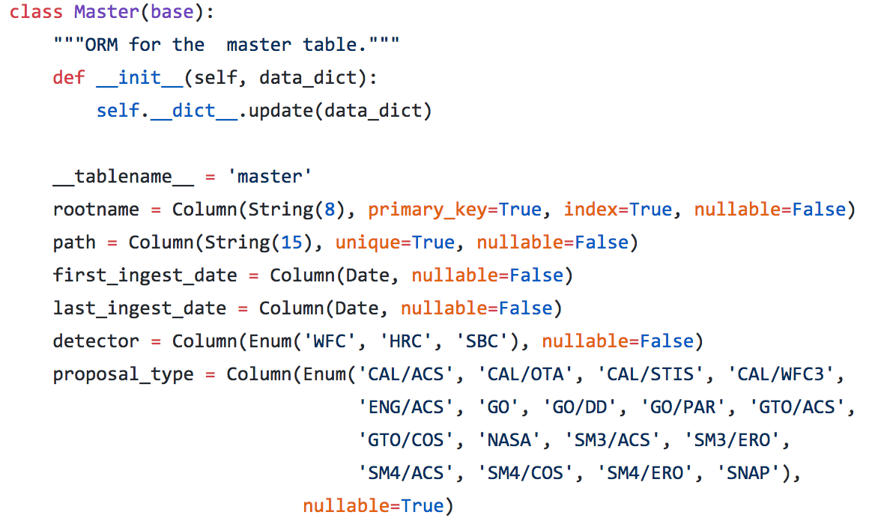
Implementation: MySQL and SQLAlchemy
SQLAlchemy: Python SQL toolkit and Object Relational Mapper

Slide 14
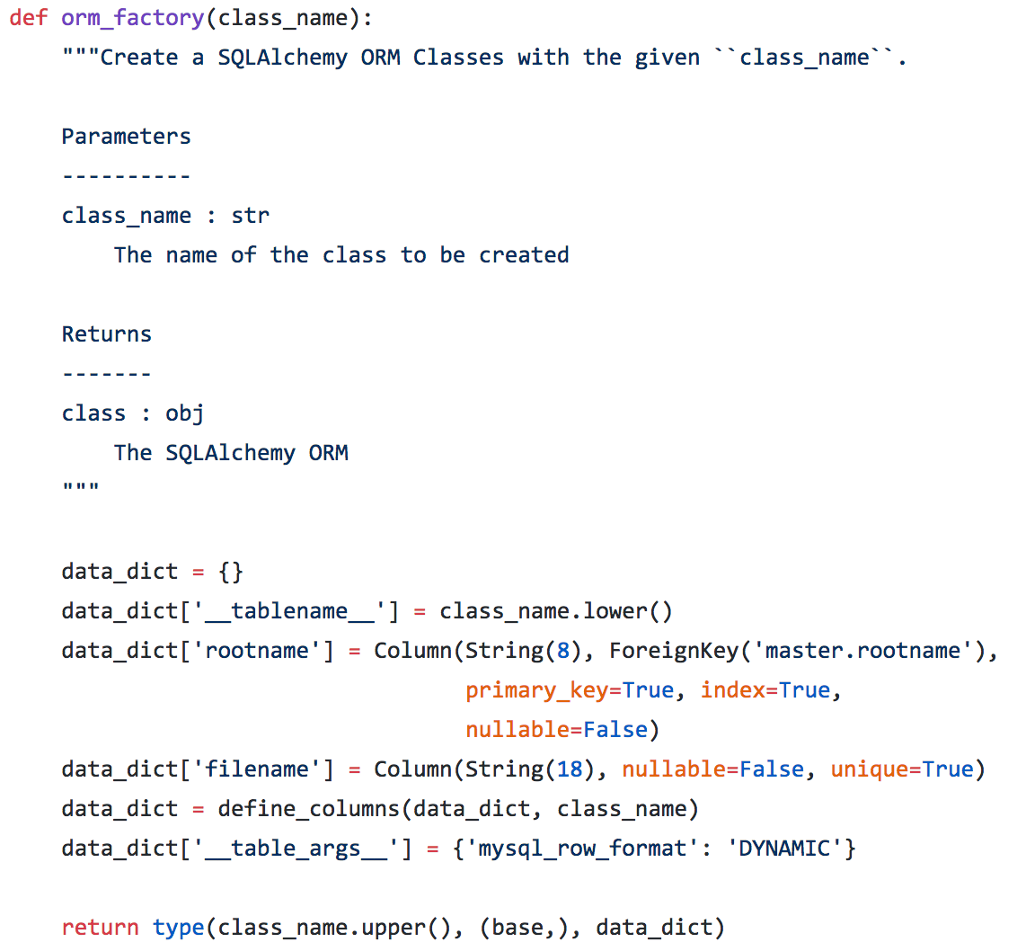
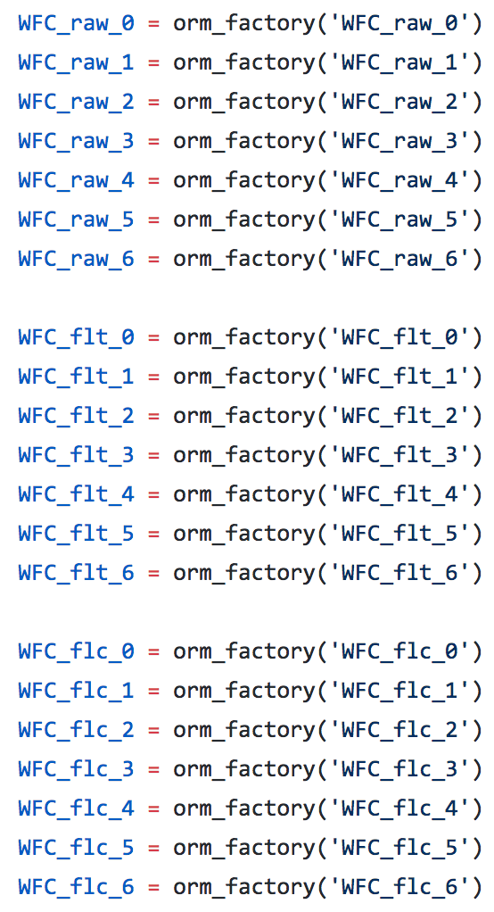
Implementation: MySQL and SQLAlchemy

Slide 15
Implementation: Data Ingestion Software Algorithm
Identify newly available data
Iterate over rootnames (using multiprocessing if necessary)
Update master table with information about rootname
Loop over available filetypes for given rootname
Create Python dictionary with metadata about file
For each FITS extension, extract header information and update header table
Update datasets table
If filetype is raw, flt, or flc, then create JPEG
If filetype is flt, then create Thumbnail
Encapsulated within ingest.py, make_file_dict.py, make_jpeg.py, make_thumbnail.py

Slide 16
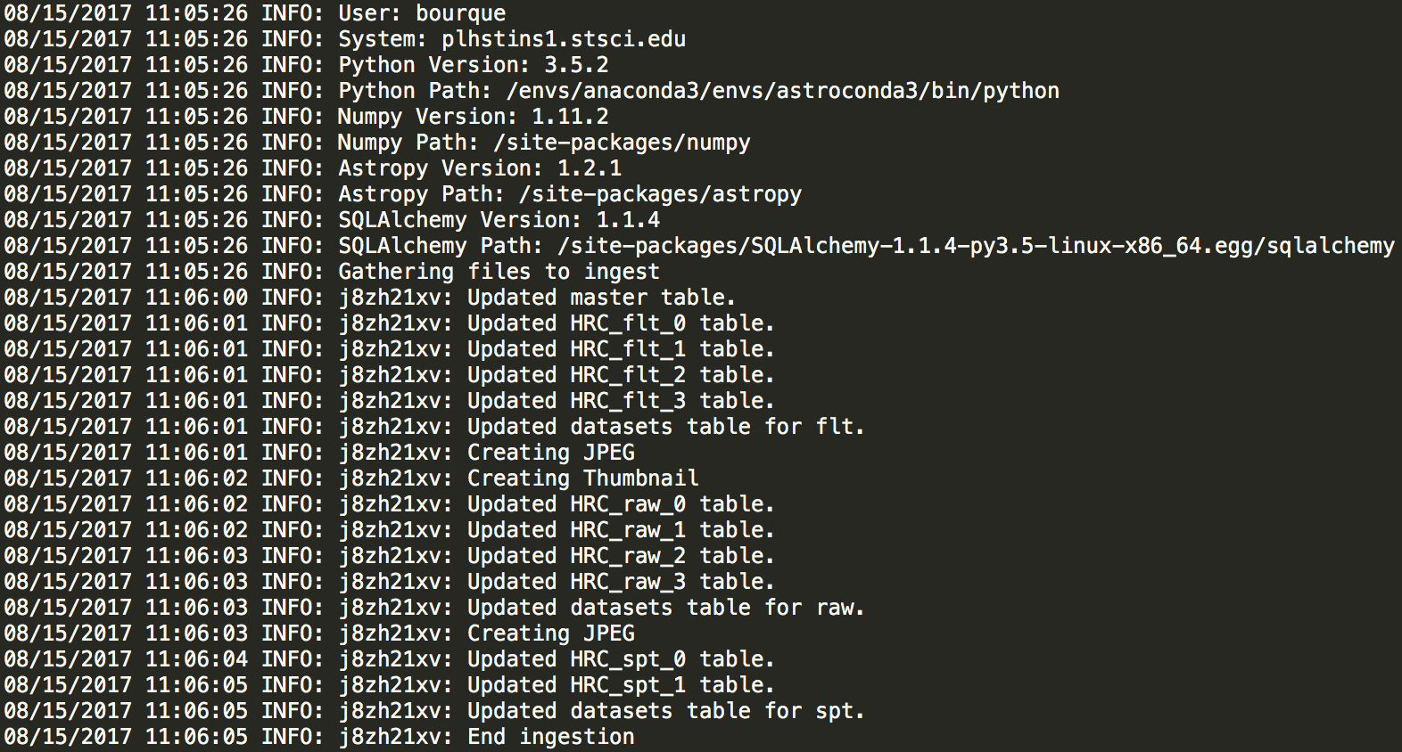
Implementation: Logging

Slide 17
Implementation: Web Application
Built using Flask, a Python-based web framework
acsql_webapp.py – Runs web application on localhost or server
data_containers.py – Various functions for gathering and returning data used by application
form_options.py – Stores data needed for database query form
query_form.py – Builds and validates database queries through web application
query_lib.py – Contains tools for executing database queries through web application
static/css/*.css – CSS templates
static/js/*.js – JavaScript functions
templates/*.html – HTML templates

Slide 18
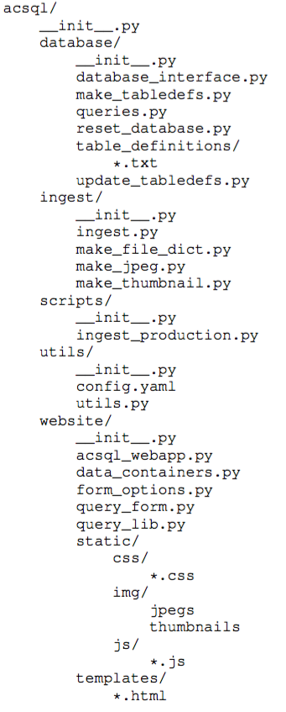
Implementation: acsql Package
Available at http://github.com/spacetelescope/acsql

Slide 19
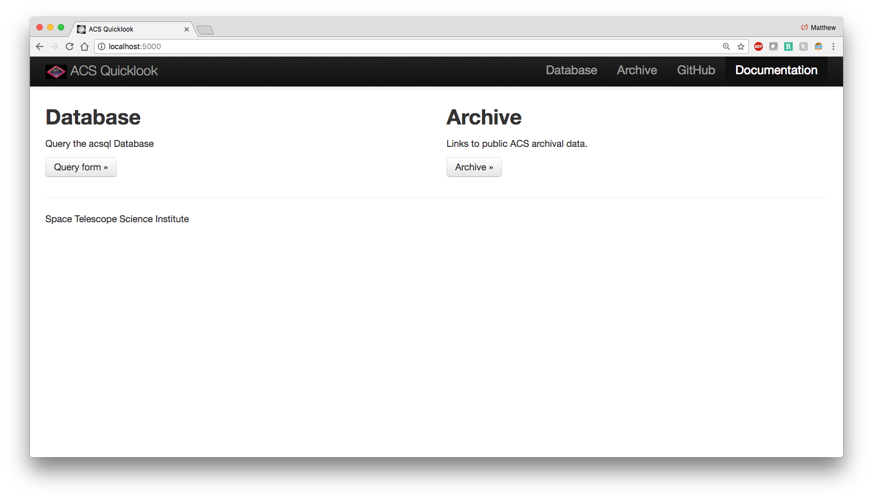
Web Application: Homepage

Slide 20
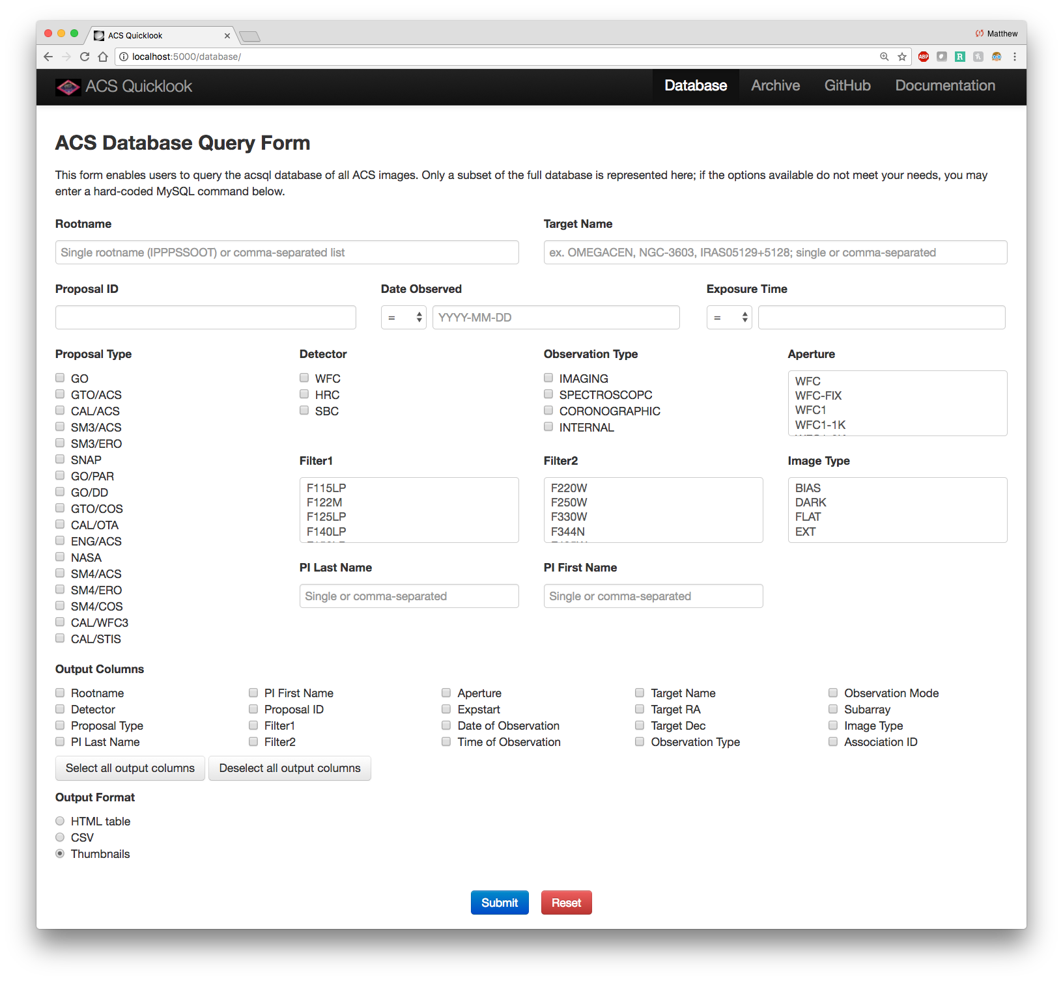
Web Application: Database Query Page

Slide 21
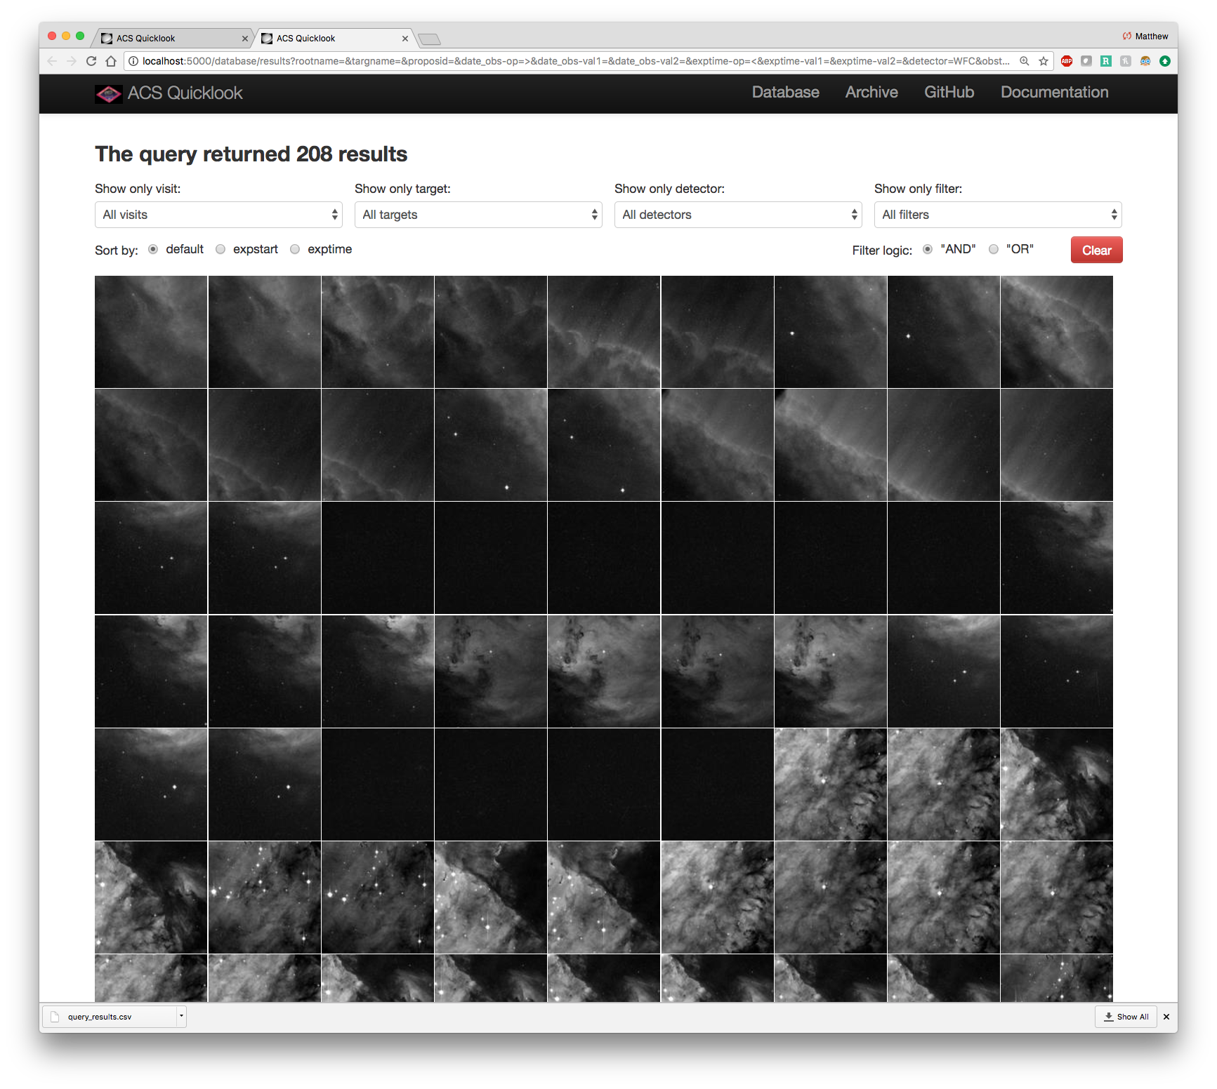
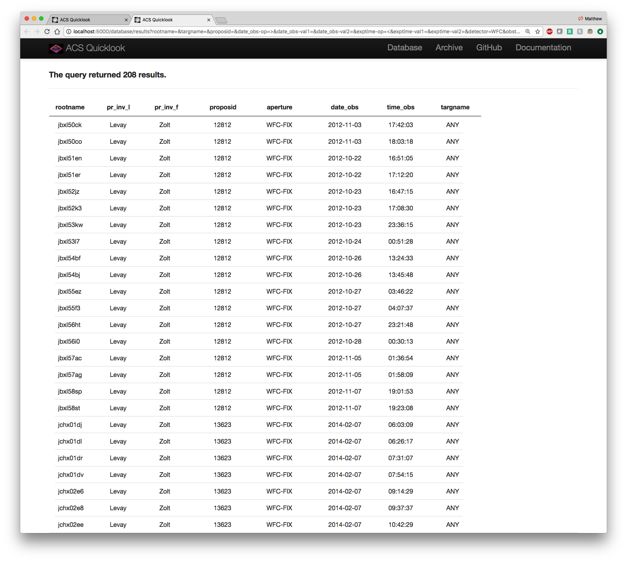
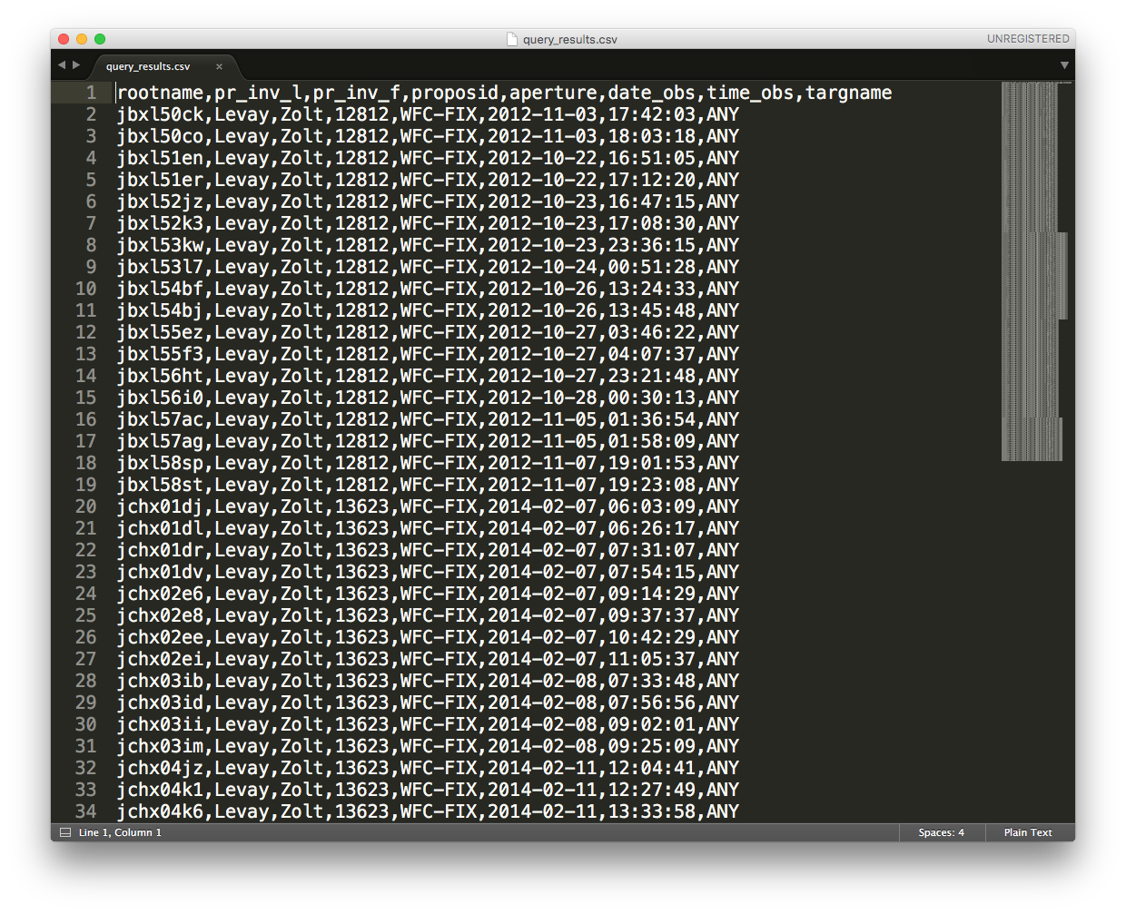
Web Application: Query Results
Thumbnails
HTML Table
CSV File

Slide 22
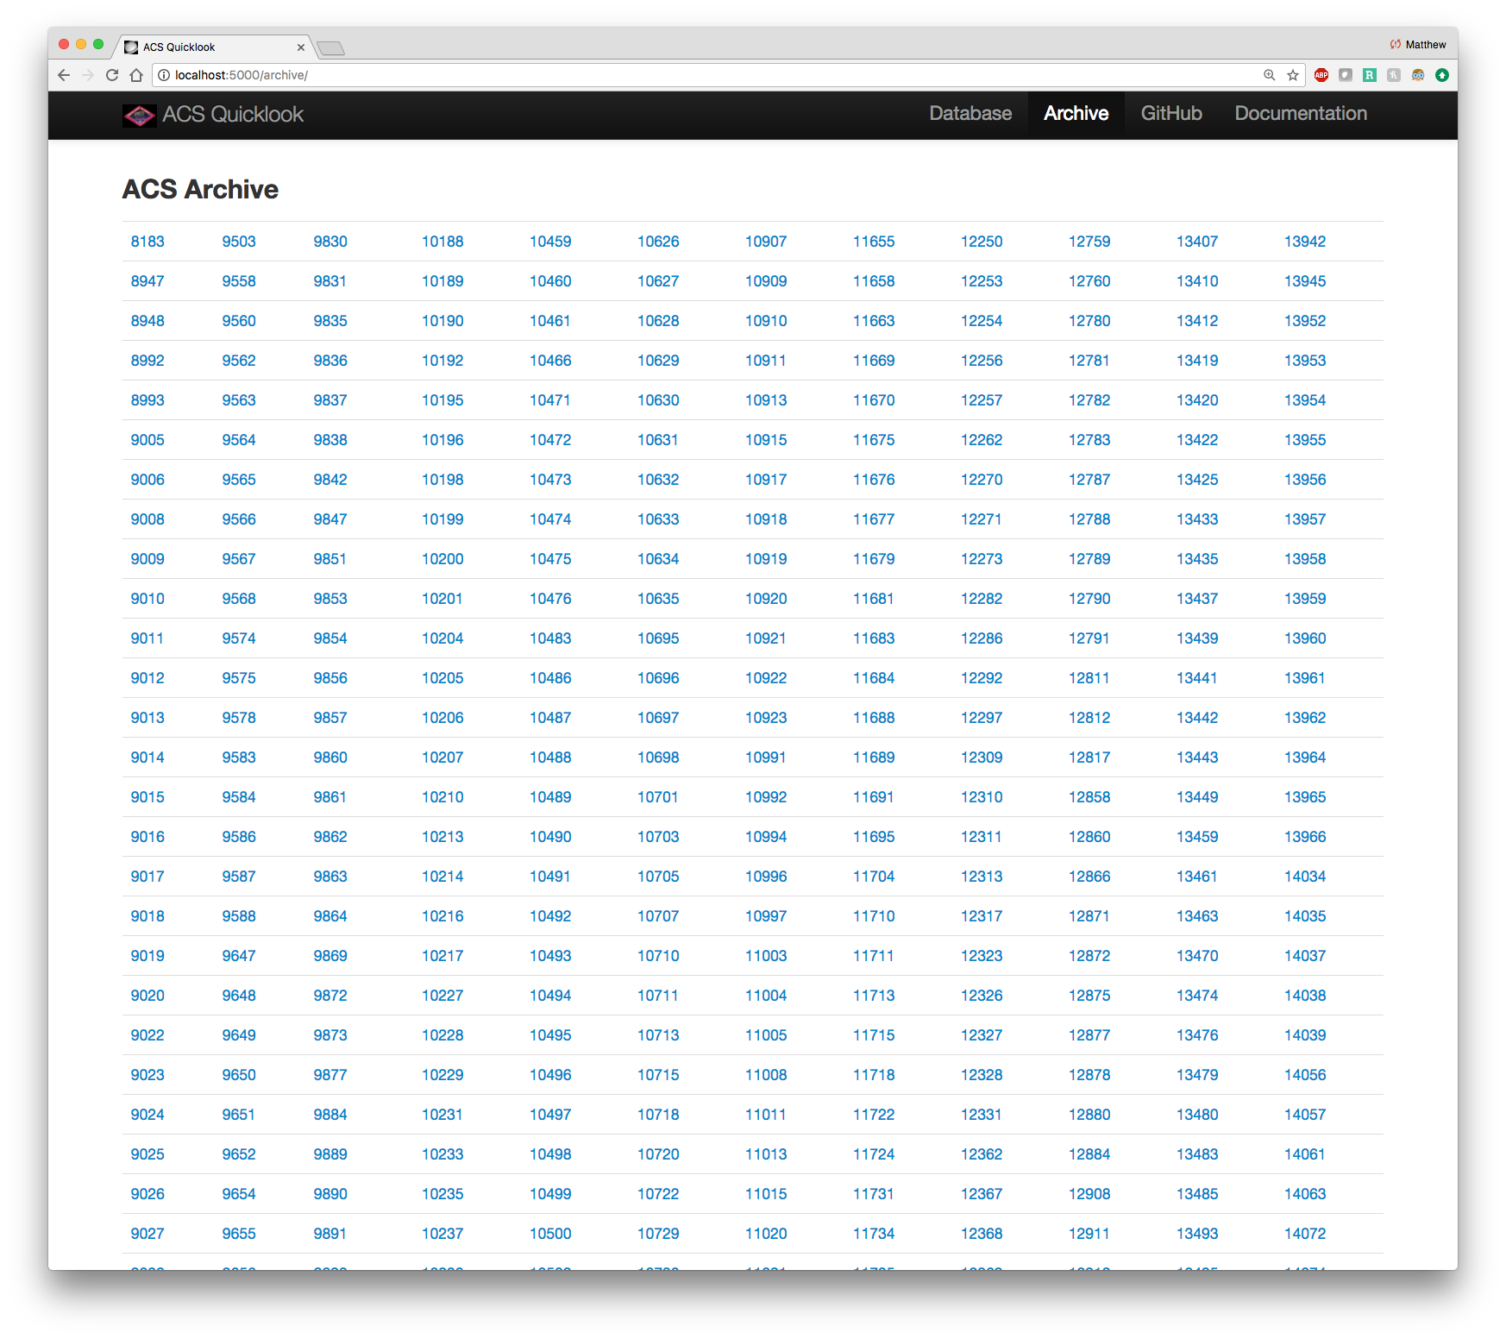
Web Application: ACS Archive

Slide 23
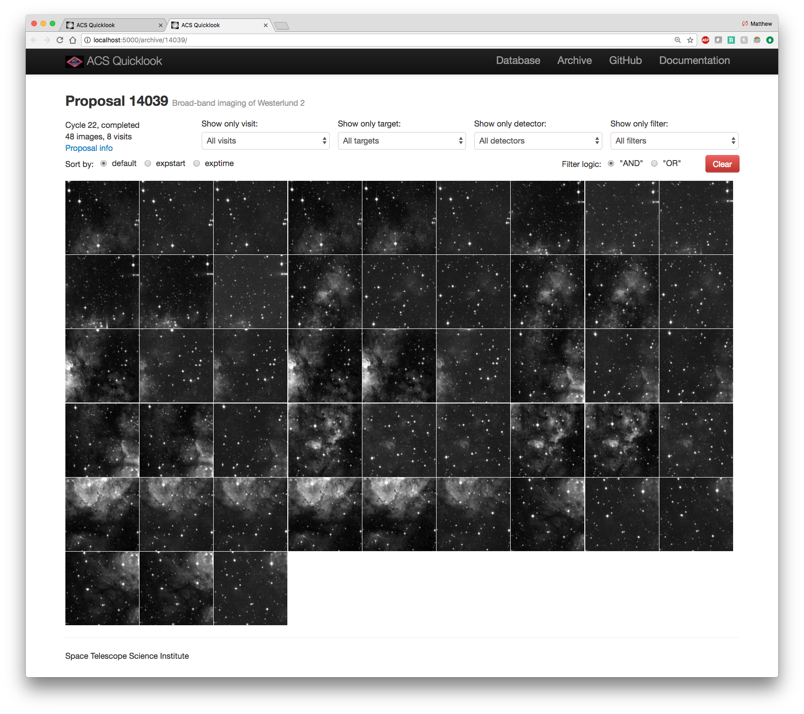
Web Application: View Proposal

Slide 24
Web Application: View Image

Slide 25
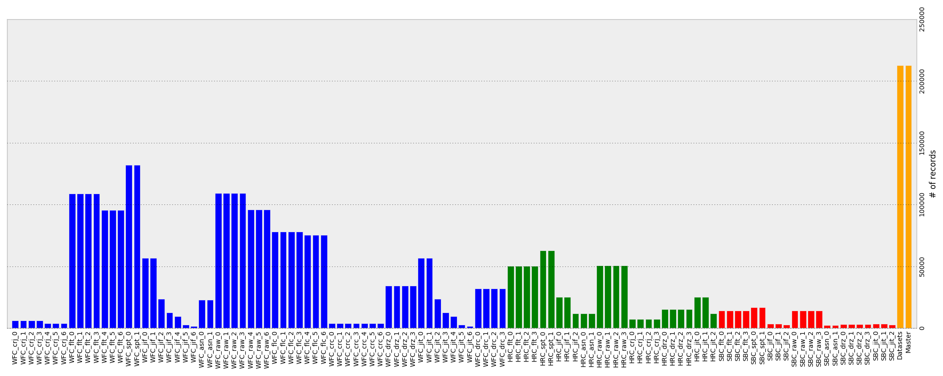
Deliverables
Database Deliverable

Slide 26
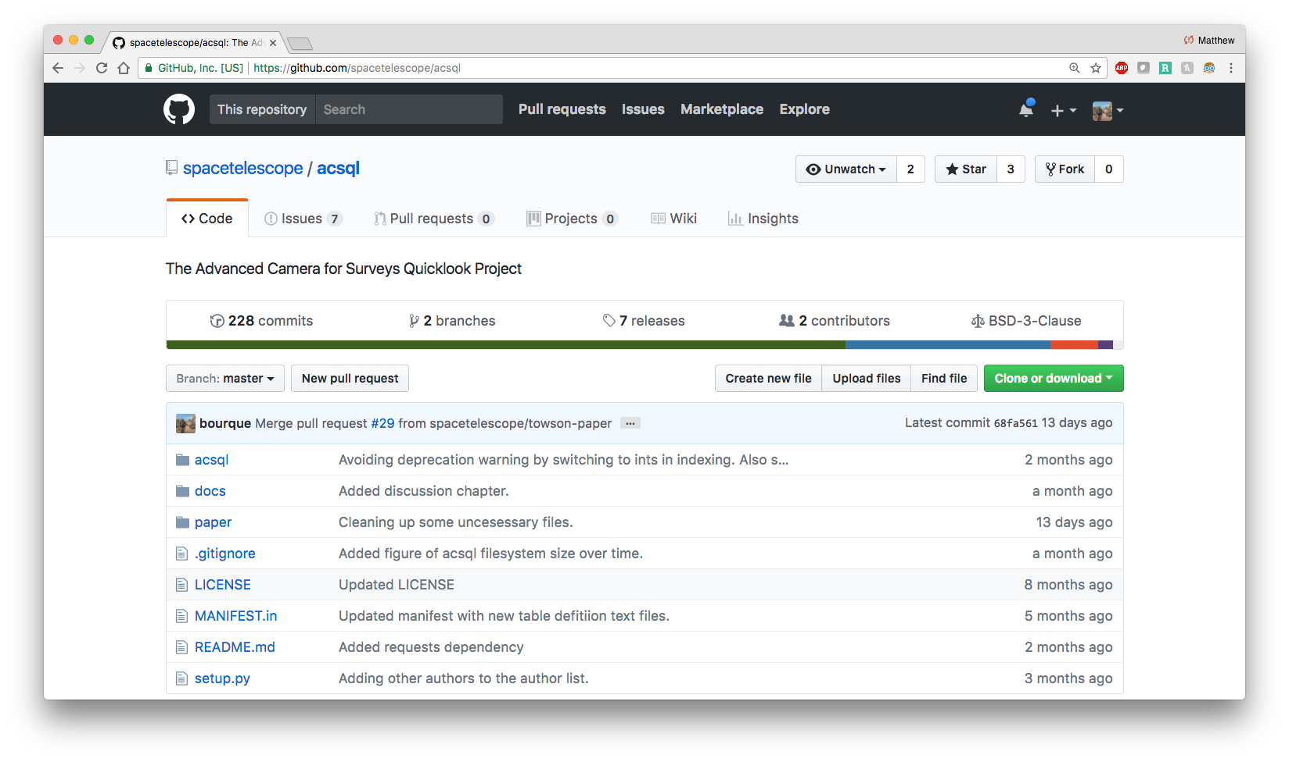
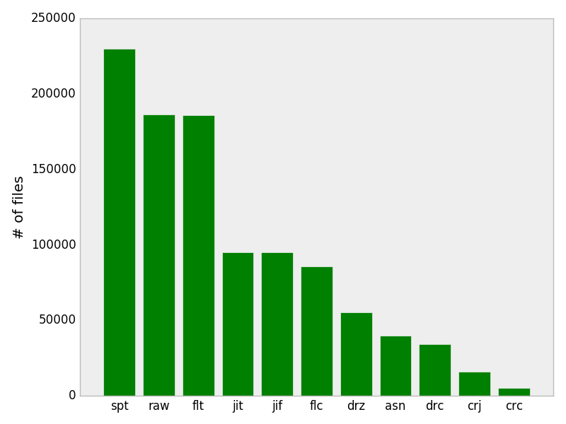
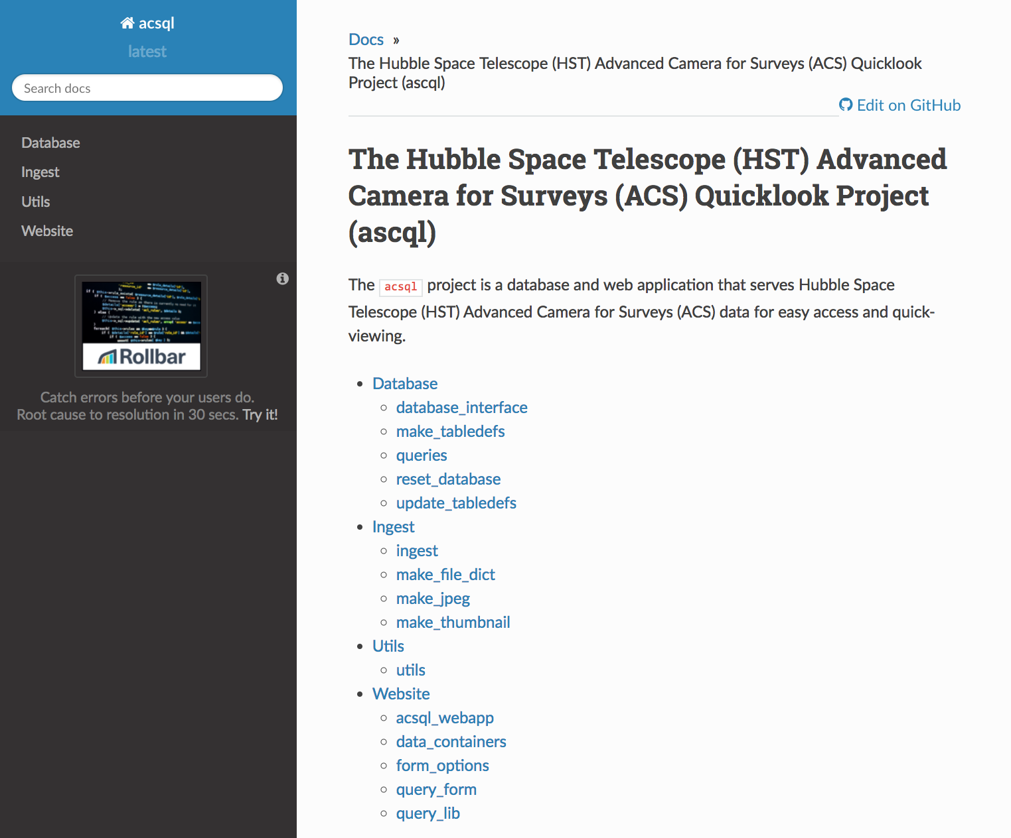
Deliverables
Software Package Deliverable
Filesystem Deliverable
Web Application Deliverable
API Documentation Deliverable

Slide 27
Acknowledgements
The ACS Instrument Team: Roberto Avila, Andreas Bellini, Ralph Bohlin, David Borncamp, Marco Chiaberge, Dan Coe, Tyler Dehjardins, Norman Grogin, Nimish Hathi, Samantha Hoffman, Pey-Lian Lim, Ray Lucas, Aparna Maybhate, Matt McMaster, Vera Platais, Jenna Ryon
The WFC3/Quicklook Team: Varun Bajaj, Ariel Bowers, Michael Dulude, Meredith Durbin, Jules Fowler, Catherine Gosmeyer, Heather Gunning, Harish Khandrika, Catherine Martlin, Jennifer Medina, Abhi Rajan, Clare Shanahan, Ben Sunnquist, Alex Viana
Other Employees of STScI: Elena Sabbi, Francesca Boffi, Alex Yermolaev, Fausat Ogunsanya, Vera Gibbs
Paper Reviewers: Sara Ogaz and Jules Fowler

